Slide 1
python FOR Loops

Slide 2

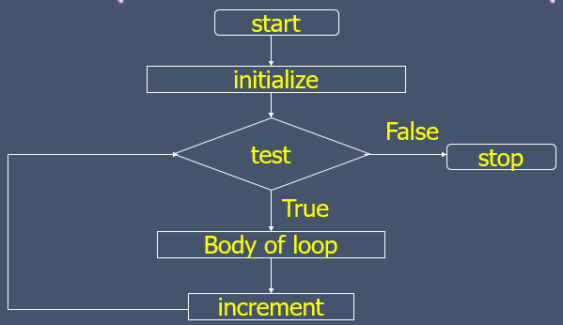
Recap – While Loop

Slide 3
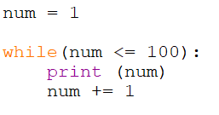
Assume that you need to print numbers from 1 to 100, while will do it for you.

Slide 4

Task 01

Slide 5
Count the total number of digits in a given number.
“

Slide 6
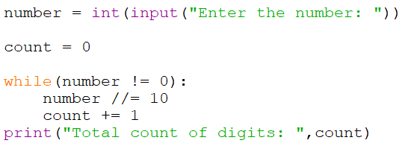

Slide 7
Reverse a given integer : 85426
“
Expected value → 62458

Slide 8
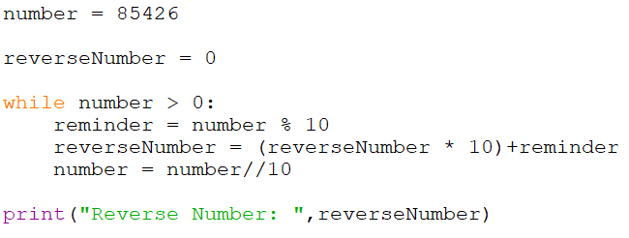

Slide 9
2 Python for Loop

Slide 10

A for loop is used for iterating over a sequence (that is either a list, a tuple, a dictionary, a set or a string).
With the for loop we can execute a set of statements, once for each item in a list, tuple, set etc.
A for loop has two sections,
A header specifying the iterating conditions
A body which is executed once per iteration
Syntax →

Slide 11


Looping through a String
#Output →

Slide 12
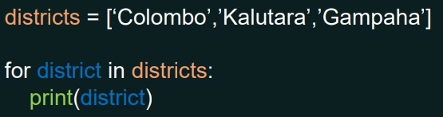
Using for loop in a Python List
#Output →
Colombo Kalutara Gampaha

Slide 13
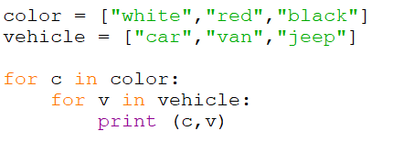
Nested for Loops
Nested loop is a loop inside another loop.
The inner loop will be executed one time for each iteration of the outer loop.

Slide 14
Using python for loop with range() function
This function returns a sequence of integers, starting from 0 by default, and increments by 1 (by default) and ends at a specified number.
range() function is used to loop through a set of values with a specified number of times.
Range function can take one, two or three parameters.
range(stop) range(start, stop)
range(start, stop, step)

Slide 15


range() function – with one parameter
Generate numbers up to the number within brackets, without including that number
#Output →

Slide 16


syntax → range( start, stop)
range() function – with two parameters
start: Starting number of the sequence.
stop: Generate numbers up to, but not including this number
#Output →

Slide 17
syntax → range( start, stop, step)
range() function – with three parameters
start: Starting number of the sequence.
stop: Generate numbers up to, but not including this number
step: Difference between each number in the sequence

Slide 18




#Output →
#Output →

Slide 19
Task 02

Slide 20
Create a program to find the sum of numbers from 1 to 10.
“

Slide 21
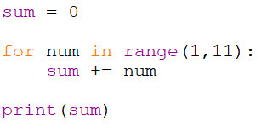

Slide 22

Thanks!
ANY QUESTIONS?

